Slide 1
CNN-RNN: A Unified Framework for Multi-label Image Classification
First Author: Jiang Wang
Report: Calvin Hung
*Disclaimer: All information presented is not my original work, but the work of the authors

Slide 2
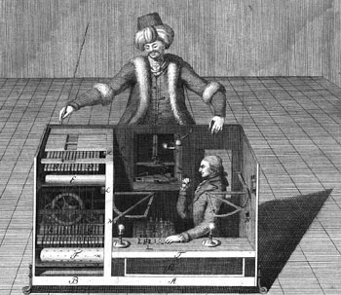
Background
More of a reminder:
Machine Learning and Neural Networks
Mechanical Turk
Quick, Draw! (Google Game)

Slide 3
Problem: Multi-labeling with CNNs
Modern Approach: Ranking with multiple single-label classification
MAIN ISSUE: Large set of labels
Cannot model higher-order correlations
Cannot sacrifice computational complexity to model complicated label relationships

Slide 4
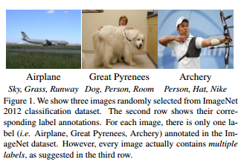

Slide 5
Problems Cont:
Label Co-occurrence dependencies
Sky & Cloud
Semantic Redundancy
Cat & Kitten

Slide 6
Hypothesis/Proposition:
Model with Recurrent Neural Networks (RNNs)
Capture higher-order label relationships
Keep computational complexity tractable
CNN-RNN Structure
Finds the dominant object
Finds subsequent objects by focusing on different regions depending on contexts

Slide 7
Proposed Advantages:
End-to-end model to handle semantic redundancy and co-occurrence dependency
Recurrent neurons is more compact and powerful
Implicit attention mechanism adapt image features to better predict small objects that need more context

Slide 8
How it Works

Slide 10
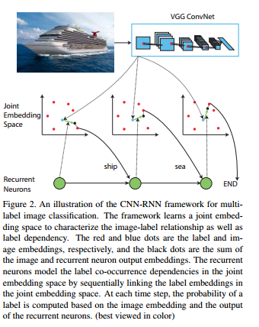

Slide 11
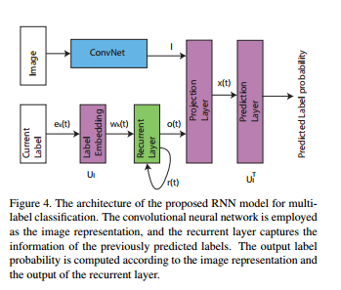

Slide 12
Results

Slide 13
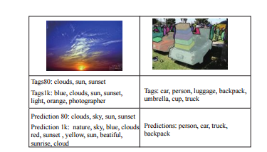

Slide 14
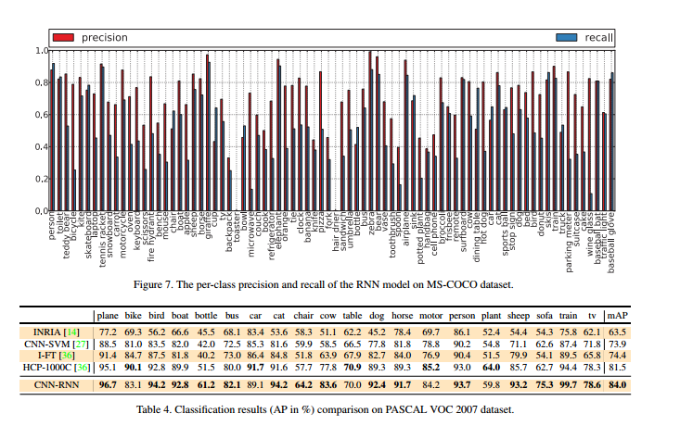

Slide 15
References/Citations
http://www.ics.uci.edu/~yyang8/research/cnn-rnn/cnn-rnn-cvpr2016.pdf
https://blogs.scientificamerican.com/guilty-planet/files/2011/07/mechanicalturk.jpg

